Slide 1
LNHS PTSA Tuesday, October 18, 2022 6:30pm General Meeting
Followed By
SOURCES OF STRENGTH &
ORANGE TECHNICAL COLLEGE

Slide 2
LNHS PTSA Meeting Agenda October 18, 2022
Agenda:
Welcome/Confirm Quorum/FB Live Attendees
Meeting Called to Order by President
Introductions/Special Guests
Position Board Members
President Christal Feldman
1st VP - Membership Brenda Meadows
Treasurer Michelle Adamick
Recording Secretary Gabriella Nguyen
Corresponding Secretary Sophia Rogers
Chairs
LWL Advisors Suzanne Arnold/Tania Abreu
Finance Gita Raghoonandan
Staff Appreciation Angie Garcia/Iris Metel
Web Master Erika Remley
Staff Liaison Kari Grimm
OLD BUSINESS
Approval of Past Minutes (September)
Review of September Financial Report
NEW BUSINESS
Membership Updates
Spirit Wear Sales
Legacy Brick Campaign
Amazon Smile
Staff Appreciation
Learn with Lions
Communication Updates/Announcements
Next Meeting - Wednesday, 11/16 at 6:30pm
Meeting Adjourned by President
October Meeting Topics: SOURCES OF STRENGTH &
ORANGE TECHNICAL COLLEGE

Slide 3
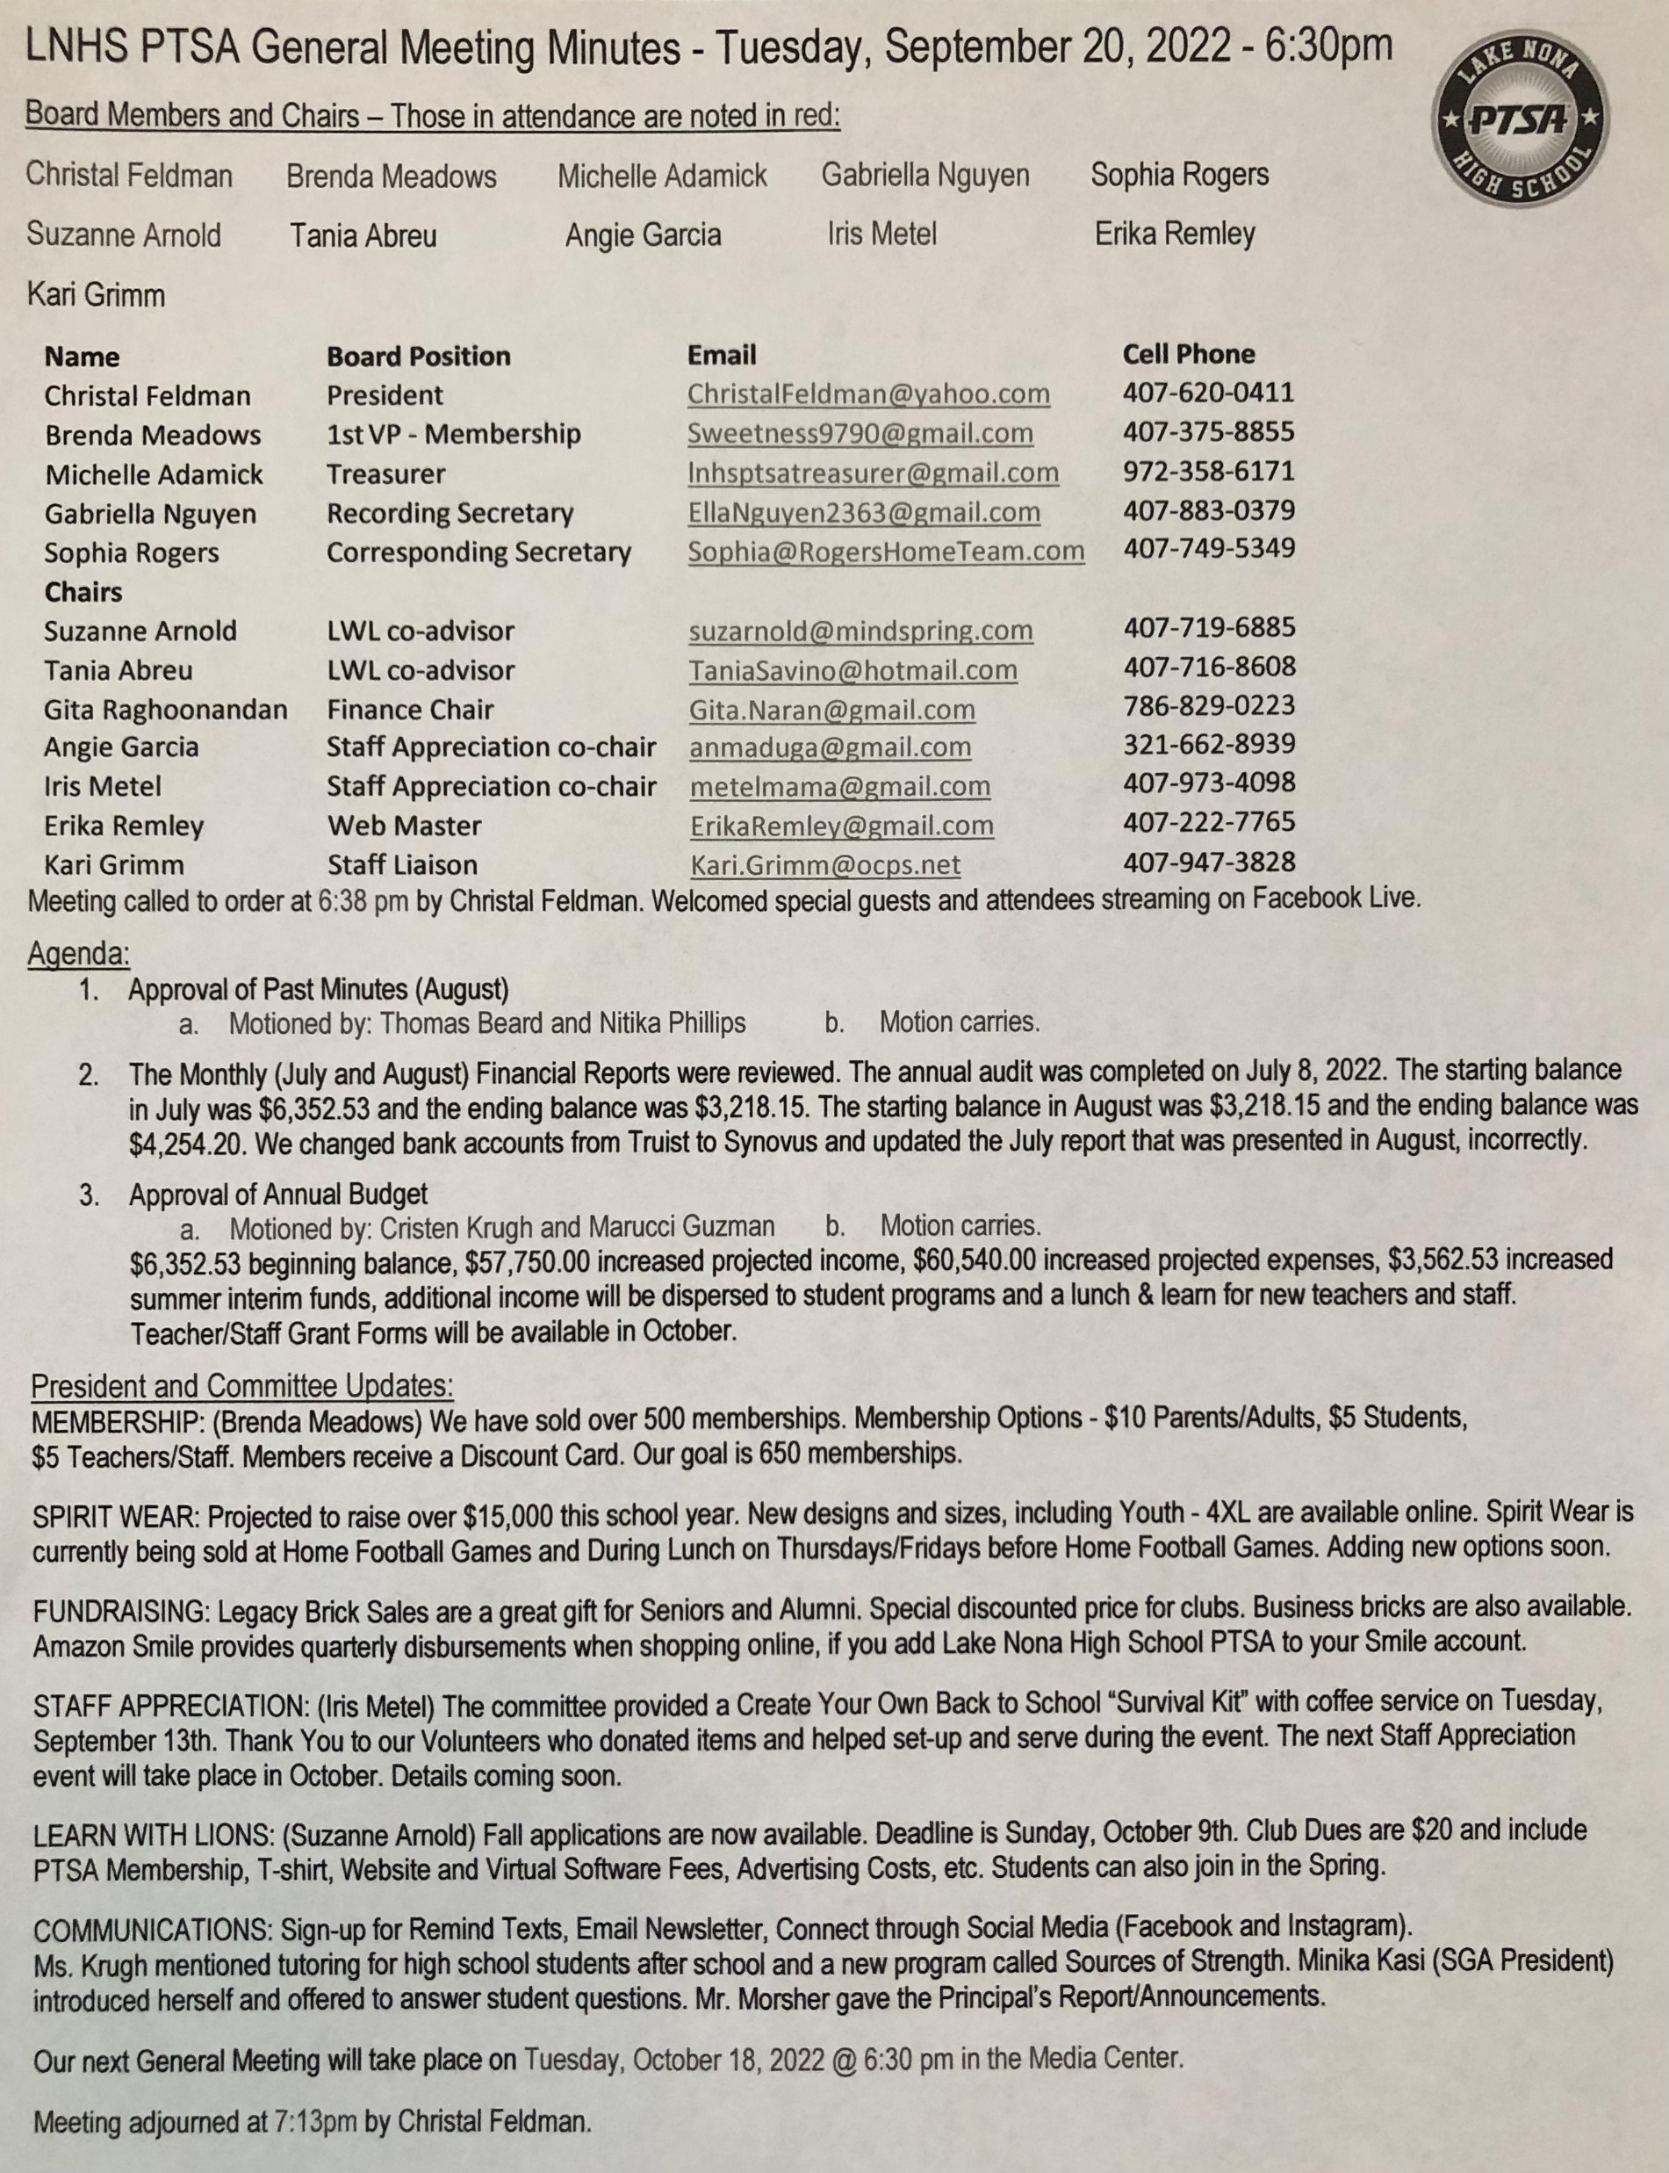
PAST MINUTES FOR APPROVAL September 20, 2022

Slide 4
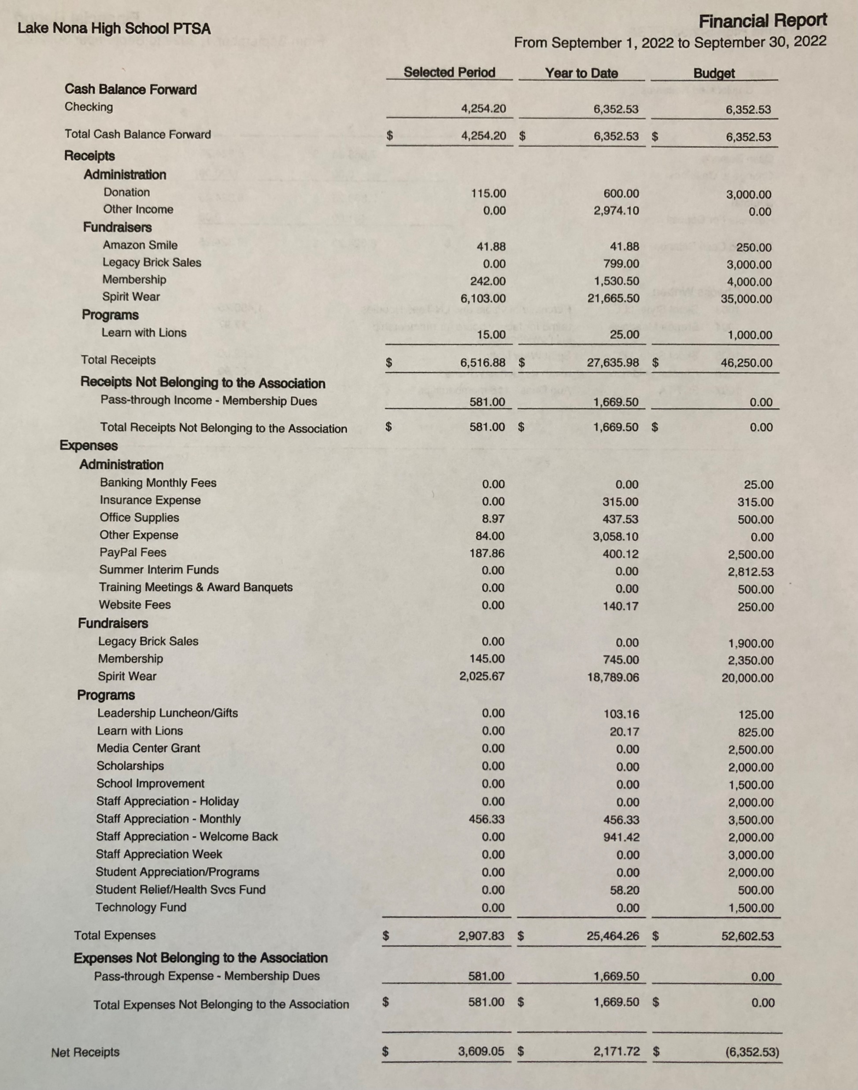
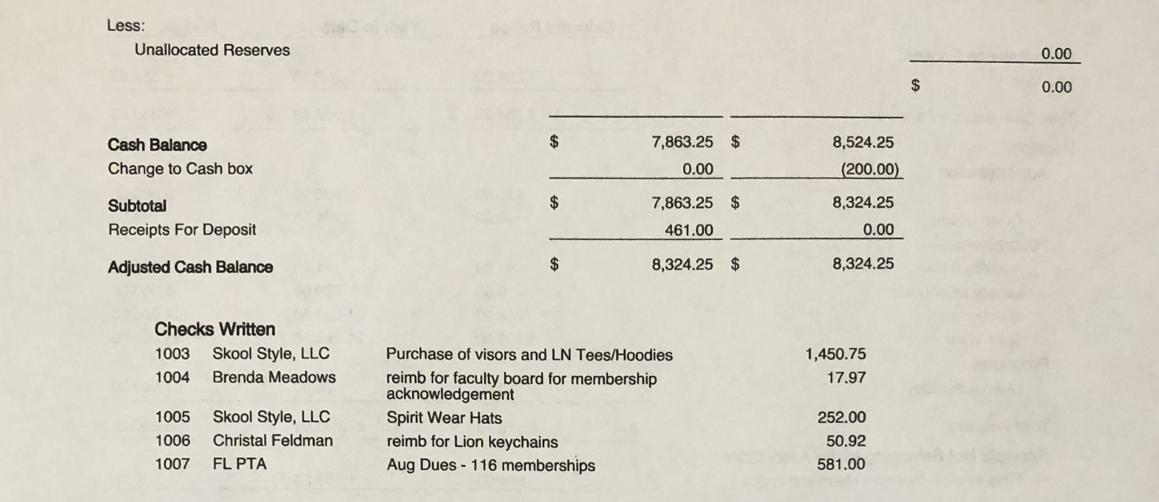
FINANCIAL REPORT FOR APPROVAL September 2022 Financial Report
Year to Date Summary September Beginning Balance - $4,254.20
September Ending Balance - $8,324.25

Slide 5
PTSA MEMBERSHIP - Currently Over 570 Memberships Received - Our Goal is 650 Memberships Membership Options Parent/Adult - $10 Teachers & Staff - $5 Students - $5 (Includes Discount Card)

Slide 6
SPIRIT WEAR - New Designs & More Sizes (Youth up to Adult 3XL) - Added Hats, Visors and Dry Fit Shirts - Stay Tuned for More Options (Sweatpants, Tank Tops, Polos and Windbreakers) - Spirit Store On Campus (Open Thursdays before Away Football Games and Thurs/Fri before Home Football Games) - Selling at Athletic Games - Projected to Raise OVER $15,000

Slide 7
LEGACY
BRICK SALES - Great Gift for Seniors & Alumni
- Special Pricing for Clubs
- Business Bricks Available

Slide 8
Add Lake Nona High School
to Your Amazon Account
while shopping ONLINE!
www.smile.amazon.com

Slide 9
STAFF
APPRECIATION
October: Mailbox Treat
November: Chili Cook-off
- Fall applications were due on October 9th.
- 49 Fall Tutors have been selected.
- Over 50 elementary and middle school students have signed up for Tutoring.

Slide 10
PTSA STAFF APPRECIATION

Slide 11
STAY CONNECTED
WITH LNHS PTSA
PTSA STAFF APPRECIATION
www.LNHSPTSA.com
www.Facebook.com/LNHSPTSA
SAVE THE DATE
Next General Meeting
Wednesday, November 16, 2022 at 6:30pm

Slide 12
LNHS PTSA October Meeting Topics
www.sourcesofstrength.org
Felicia Santiago
Angelina Whalen
www.OrangeTechCollege.net
Mrs. LuAnn Fayard

